Slide 1
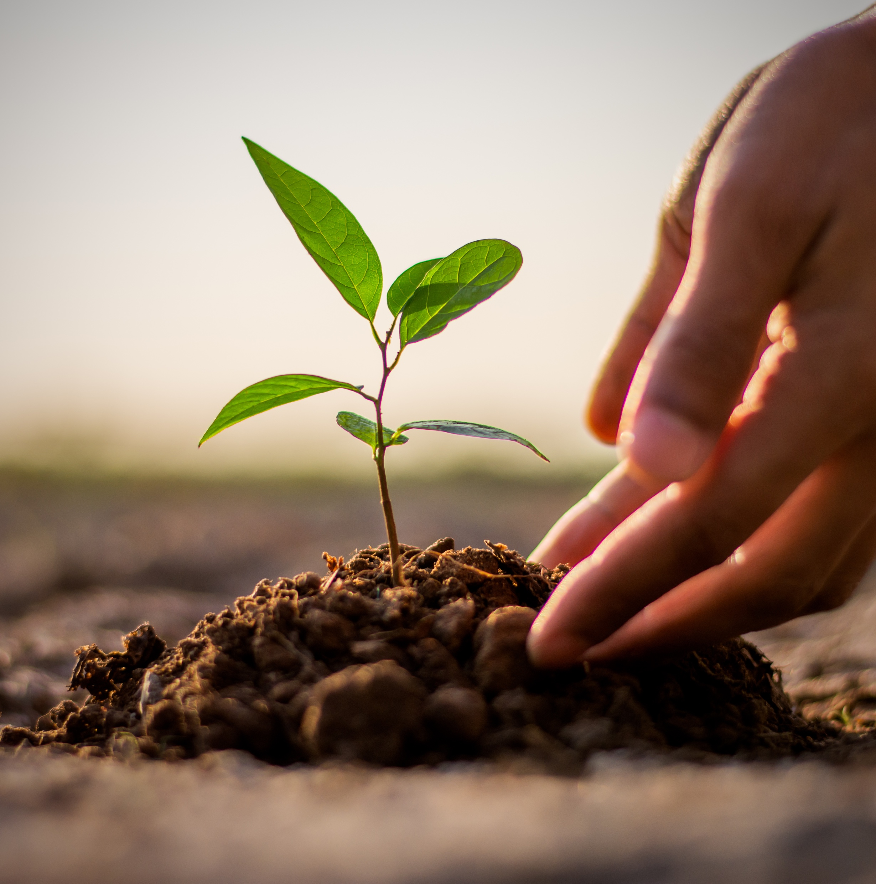
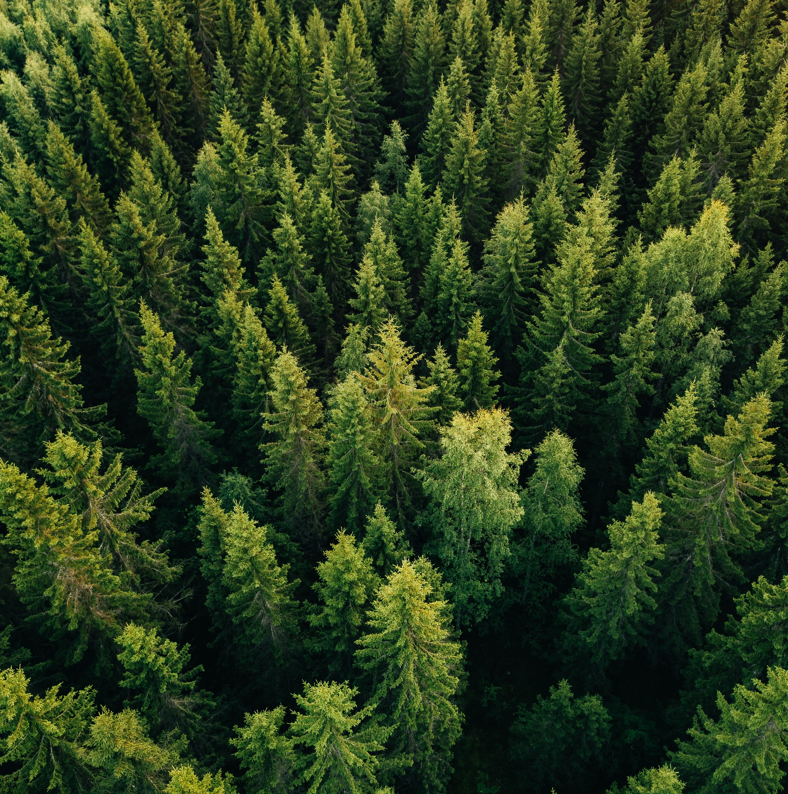
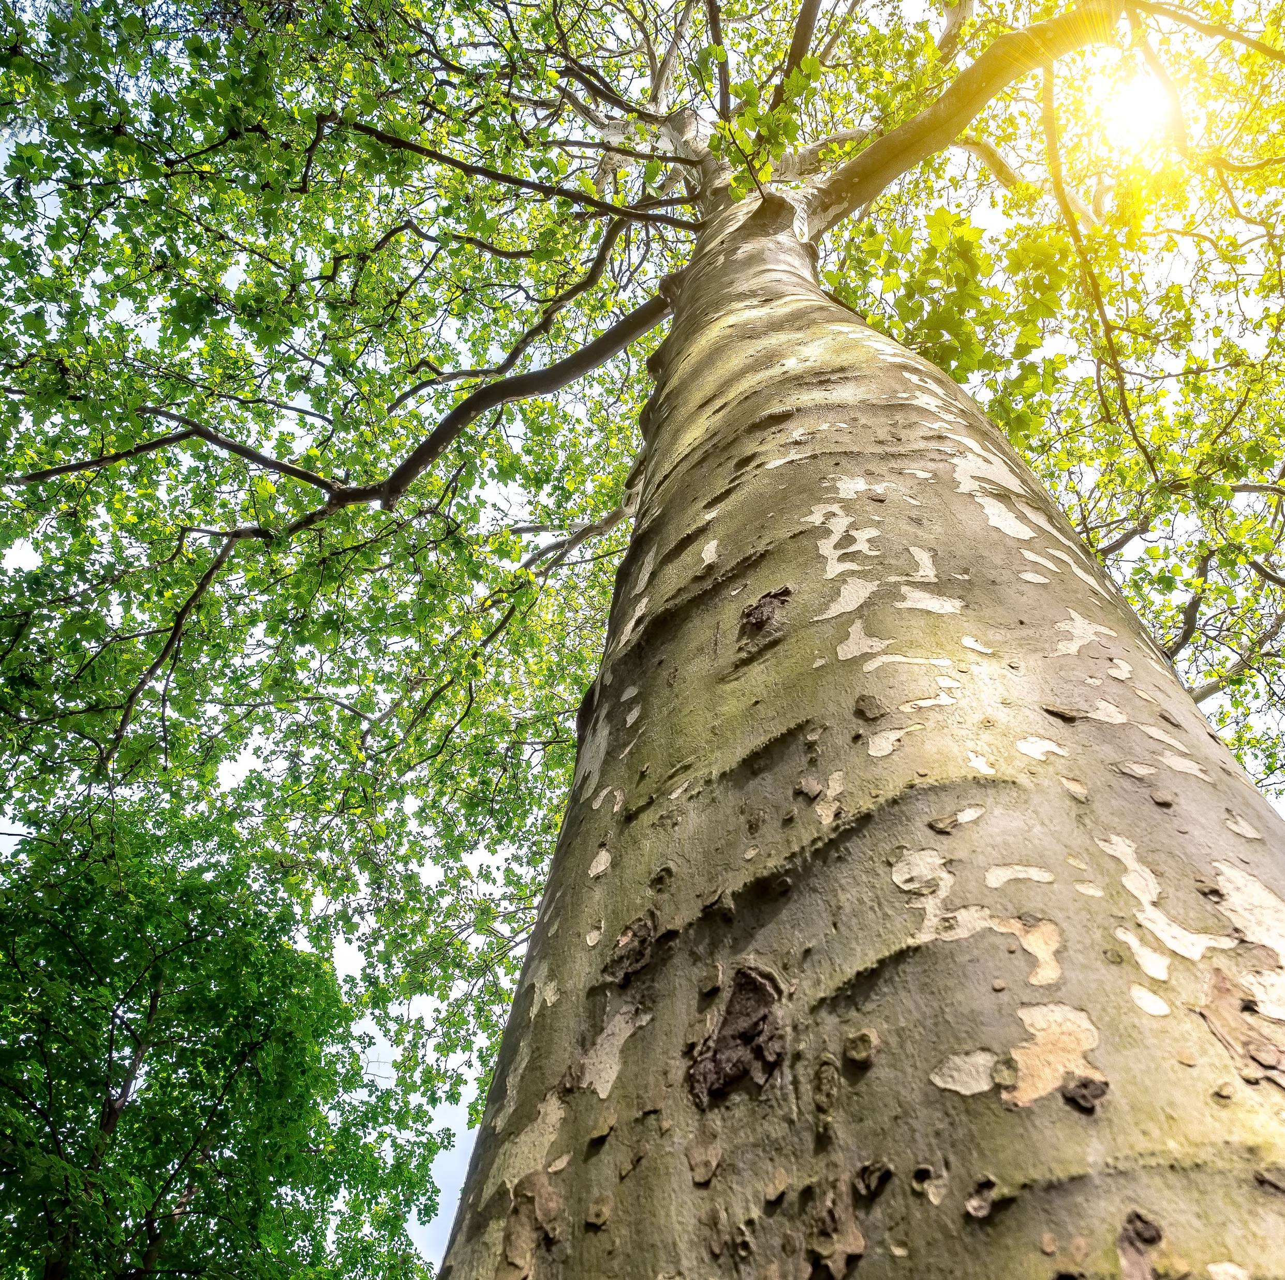
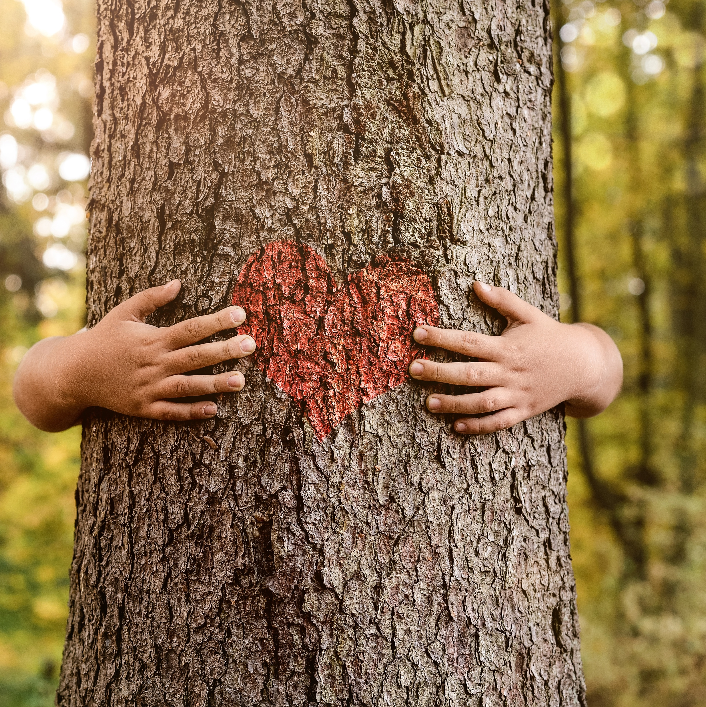
“
I
When we plant trees we plant the seeds of peace and hope
- Wangari Maathai

Slide 2
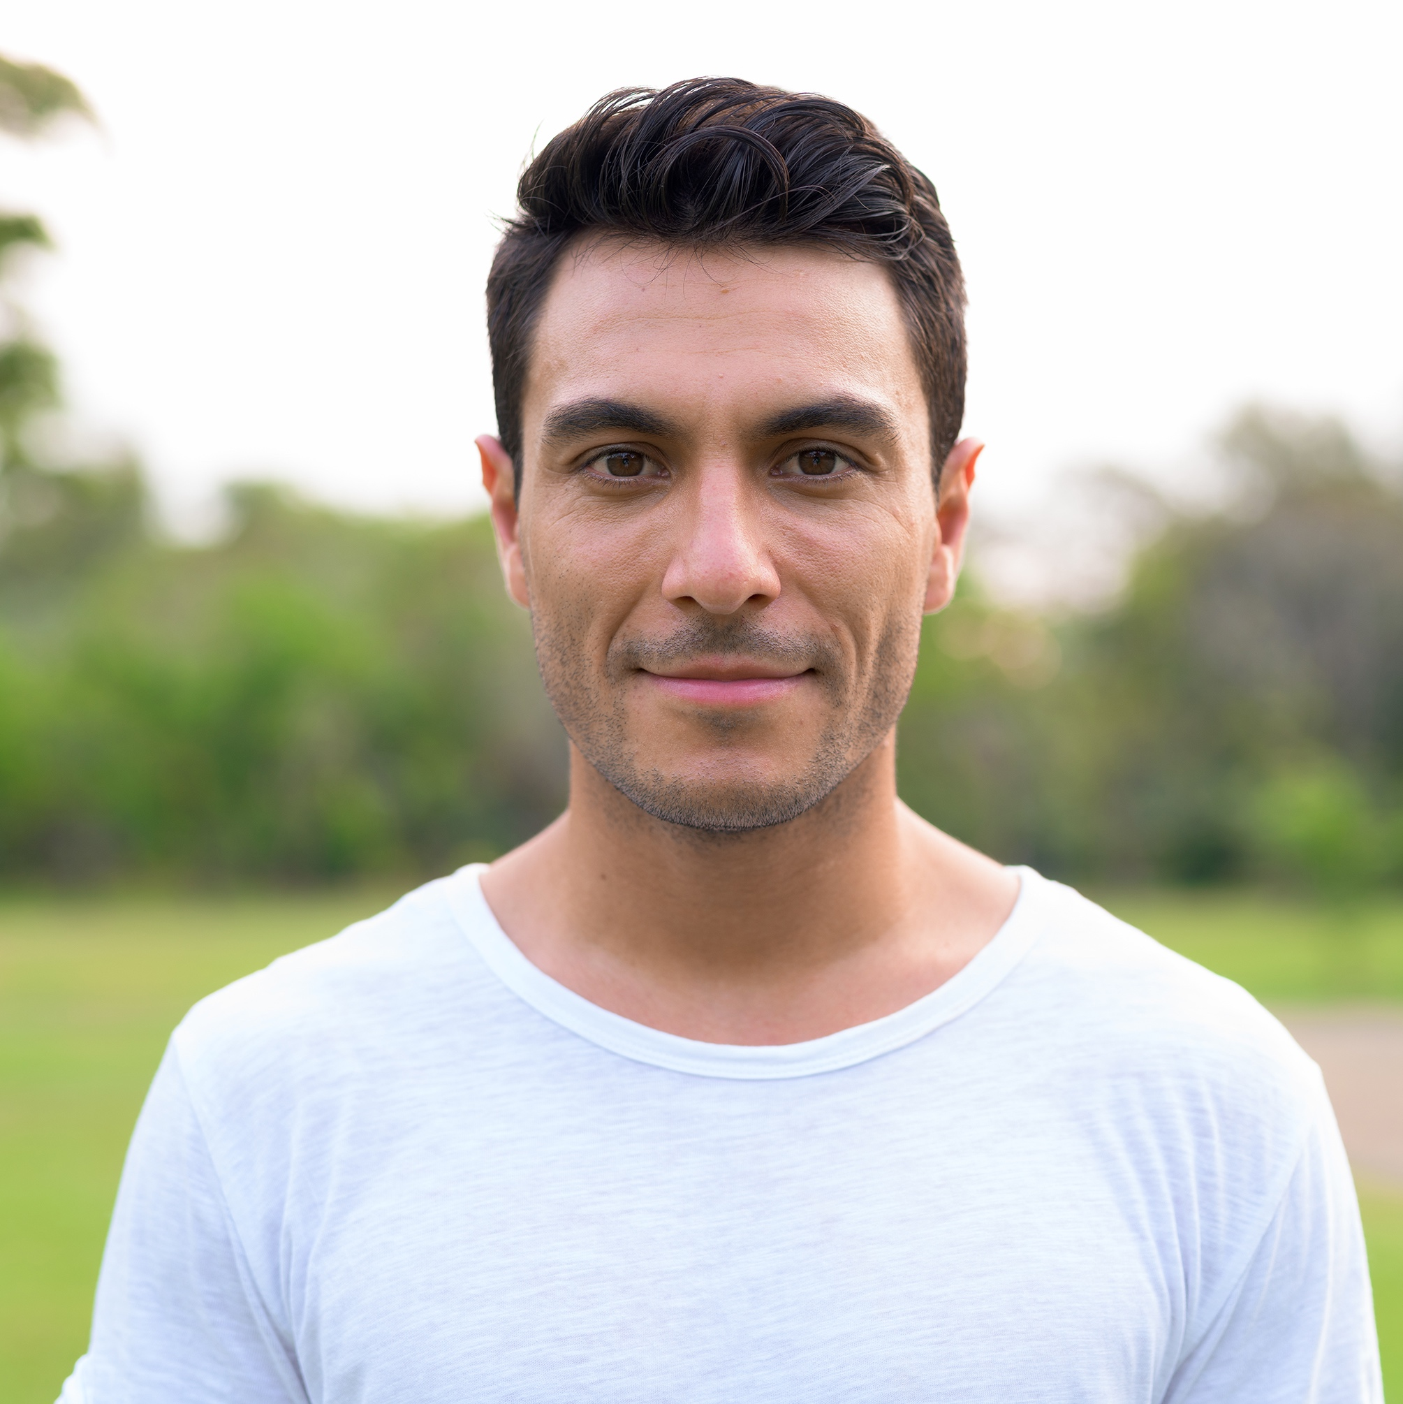
I
“
One can see from space how the human race has changed the Earth.
Nearly all of the available land has been cleared of forest and is now used for agriculture or urban development. The polar icecaps are shrinking and the desert areas are increasing. At night, the Earth is no longer dark, but large areas are lit up. All of this is evidence that human exploitation of the planet is reaching a critical limit. But human demands and expectations are ever-increasing. We cannot continue to pollute the atmosphere, poison the ocean and exhaust the land. There isn’t any more available.”
- Stephen Hawking
Physicist & Author

Slide 3
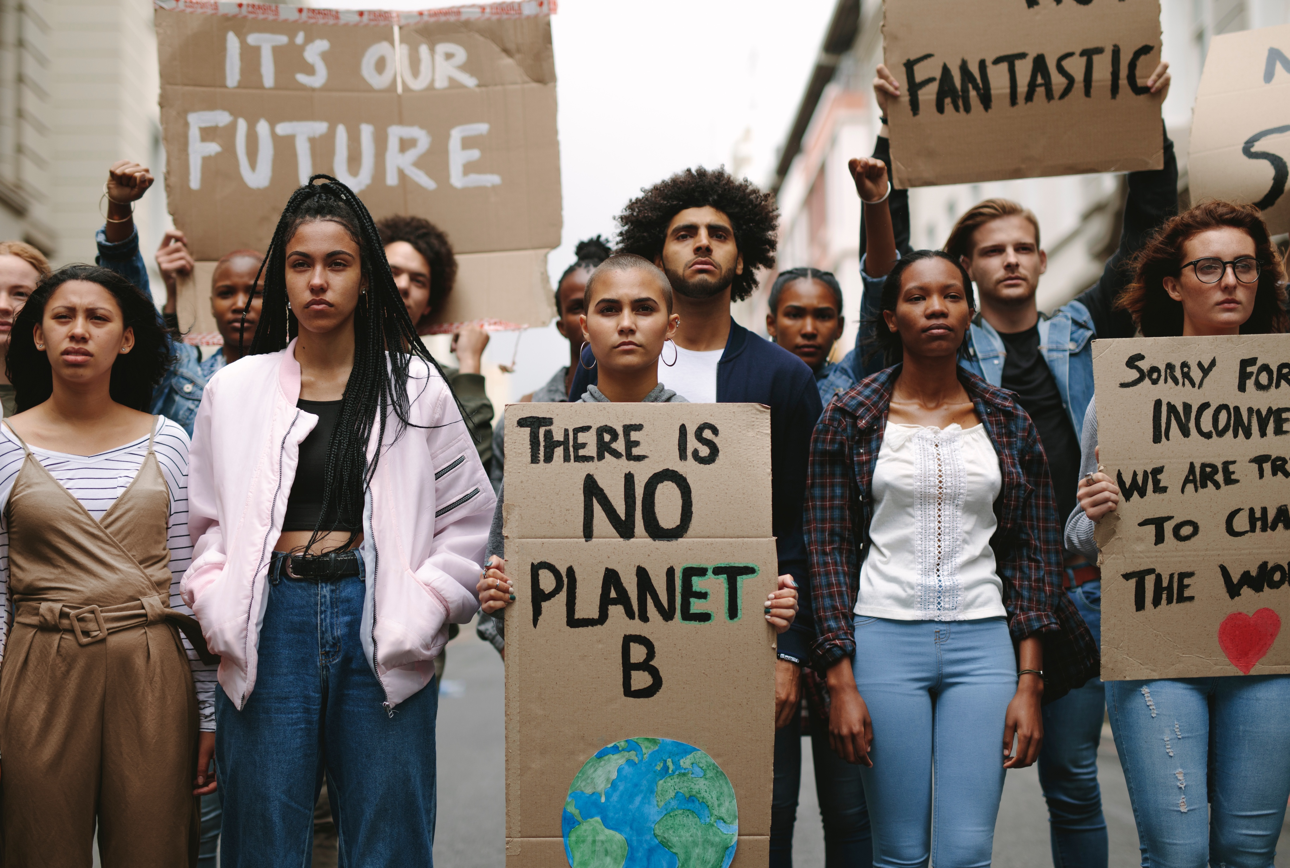
Join the Climate Revolution!
ACT NOW!

Slide 4
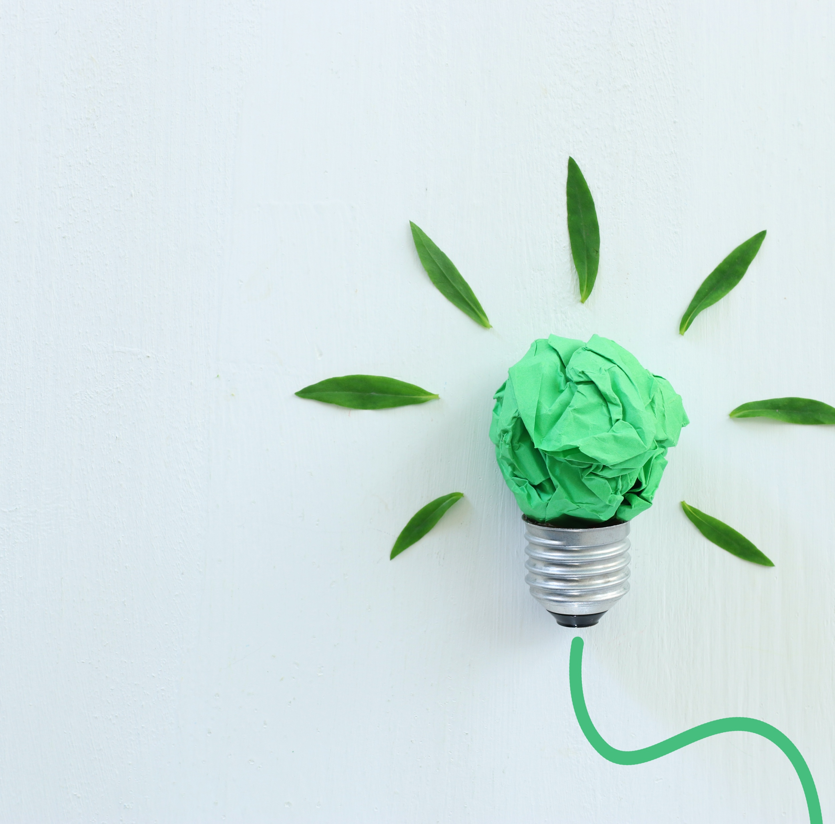
What are your GREEN IDEAS for the future?
Tell us in the comments!

Slide 5
I
6
Ways to Cope with Climate Change

Slide 6

I
1
Acknowledge that your feelings are valid
2
Reframe your thinking

Slide 7
I
3
Start Small – changing habits cannot be done overnight
4
Look for credible information

Slide 8
I
5
Reconnect with Nature
6
Remember that you’re part of a community
(in-person and digital!)

Slide 9
I
Want to become a more conscious consumer?
3 things to ask before you buy:
1
Is it necessary?
2
How might this product impact people and the environment?
3
From who or where is the product coming?

